Slide 1
Formal Methods in Software Engineering

Slide 2
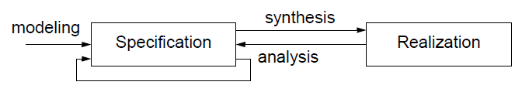
Formal Methods
Formal Method (FM)
  Specification language
    A special way of writing rules for what the system should do — like a contract or instructions.
  Formal reasoning
    Using logic and proofs (not just testing) to make sure the system is right.
Body of techniques supported by
  Precise mathematics
    Everything is clearly defined, so there’s no confusion.
  Powerful analysis tools
    Special computer tools are used to check and prove the system's behavior.
Rigorous, effective mechanisms for system
  Modeling
  Synthesis
  Analysis

Slide 3
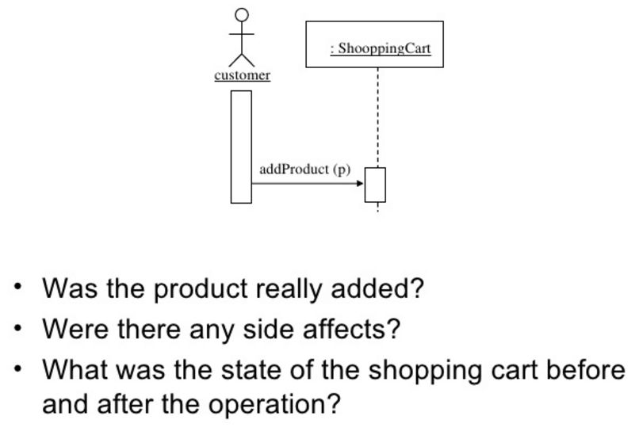
Motivation for Formal Specification

Slide 4
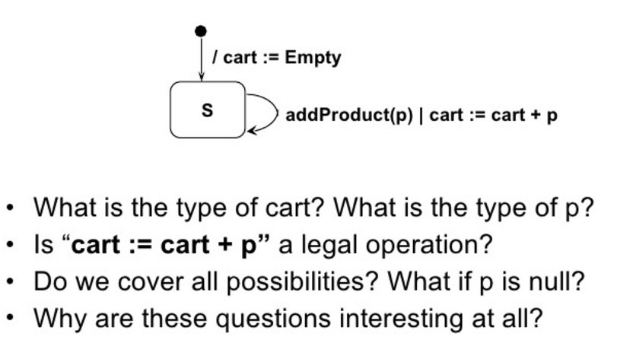
Motivation for Formal Specification

Slide 5
Formal Specification
Requirements specification
  Notational statement of system services
Software specification
  Formal abstract depiction of system services
Architectural specification
  Graphical representation of system structure
  Formal abstract depiction of key system properties
Module specification
  Formal module interface, behavior, interaction specifications

Slide 6
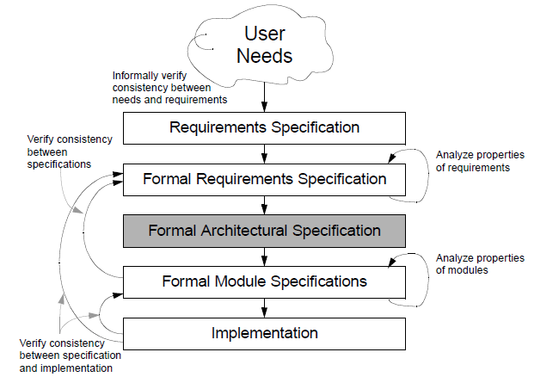
Formal methods in software development

Slide 7
Desirable properties of Formal Specification
Unambiguous
  exactly one specific and (set) satisfies it
  e.g., “Component X has a single port on its top and bottom”
Consistency
  a specificand exists that satisfies it
  e.g., interfaces of interacting components must match
Completeness
  all aspects of specificand are specified
  e.g., interfaces of all components must be specified
  may be achieved incrementally
Inference
  consequence relation used to prove properties about the specificands that satisfy a specification

Slide 8
Formal Specification in software development
Formal specifications based software development process is well-defined.
Orientation goes from customer to developer
Formal specifications are expressed in languages with formally defined syntax and semantics
  hierarchical decomposition
  mathematical foundation
  graphical presentation
  accompanied by informal description

Slide 9
Types of Formal Specifications
Model-oriented specifications
  specify system behavior by constructing a model in terms of well-defined mathematical constructs
Property-oriented specifications
  specify system behavior in terms of properties that must be satisfied
Visual specifications
  specify system structure and behavior by graphical depictions
Executable specifications
  specify system behavior completely enough that specifications can run on a computer
  this is not programming

Slide 10
Types of Formal Specifications
Behavioral specifications describe constraints on the behavior of specificand – e.g.,
    functionality
    safety
    security
    performance
Structural specifications describe constraints on the internal composition of specificand
    module interconnection
    uses and is-composed-of
    dependence relations

Slide 11
Basic Specification Language Types
Abstract Model Specifications
defines operations in terms of well-defined mathematical model
Algebraic Specifications
defines operations by a collection of equivalence relations
State Transition Specifications
defines operations in terms of states and transitions
Axiomatic Specifications
defines operations by logical assertions

Slide 12
Abstract Model Specifications
Explicitly describes behavior in terms of a model using well-defined types (sets, sequences, relations, functions) and defines operations by showing effects on model
Specification includes
    type: syntax of object being specified
    model: underlying structure
    invariant: properties of modeled object
    pre/post conditions: semantics of operations
Pros and Cons
    state is made explicit in model
    suggests an implementation
    widely applicable because of modeling orientation
Various notations: VDM, Z, RAISE

Slide 13
Algebraic Specifications
Specification includes
    functionality: syntax and legal constructions
    relations: semantics by equivalence classes
Pros and Cons
    only pure functions described (no side effects)
    supports extensibility of data abstractions
    often hard to comprehend and construct
    particularly applicable to abstract data types
Various notations: OBJ, Larch, Clear, Anna

Slide 14
State Transition Specifications
Explicitly describes system behaviour by a set of states and defines operations as transitions between states or observations on state
Specification includes
    states: possible values
    transitions: semantics by state transformations and observations
Pros and Cons
    free of representational details (except augmentations)
    state explosion is common
    extensions to minimize states and modularize
    particularly applicable to control systems, languages, hardware
Graphical as well as textual notations: StateCharts, ASLAN, Paisley,InaJo, Special

Slide 15
Axiomatic Specifications
Implicitly defines behavior in terms of [first-order] logic formulas specifying input/output assertions (and possibly intermediate assertions)
Specification includes
    operation interfaces: input/output parameters
    operation axioms: pre/post assertions on input/output
Pros and Cons
    fairly easy to understand
    widely applicable (although hard to scale up)
    most widely used technique in proving (inductive assertion method)
    foundation of mathematics in software development
Many languages support this type of specification:
    Extensions include various logics for specific application domains (e.g., temporal logic: RTIL, GIL)
    VDM, Anna

Slide 16
Integrating Formal Methods in Development
Option 1: business as usual with after-the-fact verification
  formal specification constructed after system implementation
  implementation checked for consistency against the specification
  increases confidence in the system
  time- and money-consuming

Slide 17
Integrating Formal Methods in Development
Option 2: verification in parallel
  two teams — development team and formal verification team
  requires constant communication between the two teams
  may degenerate into option 1 due to poor communication
  less time consuming but as expensive as option 1
Option 3: integrated verification
  one team that does development and formal verification
  single integrated development process
  better, cheaper, and faster than options 1 and 2

Slide 18
Formal Specification
Intended to remedy the seven sins of the specifier
noise / redundancy
Silence -- missing
Over specification
contradiction
ambiguity
forward reference
wishful thinking

Slide 19
Thanks

Slide 20
References
https://www.slideshare.net/erant/formal-modeling-with-z
https://www.slideshare.net/Falguni_Roy/z-specification

